Slide 1

Supervised Learning Breast Cancer
October 14, 2025
1. Problem Definition & Goal
Task: Binary classification — predict whether a tumor is malignant (1) or benign (0) from diagnostic features.
Why it matters: Early, accurate triage can help prioritize clinical review.
Objective: Build and compare several supervised models; select the best based on cross‑validated performance and held‑out test metrics (ROC‑AUC, F1).
2. Data Source & Description
Dataset: Breast Cancer Wisconsin (Diagnostic) —
available via
sklearn.datasets.load_breast_cancer() (Wolberg, Street, Mangasarian).
Samples: ~569; Features: 30 numeric diagnostic measurements (radius, texture, smooth- ness, etc.).
Target: 0=benign, 1=malignant.
I will load the dataset from scikit‑learn to keep this project self‑contained.
[12]:
import numpy as np
import pandas as pd
import matplotlib.pyplot as plt
from sklearn.datasets import load_breast_cancer
from sklearn.model_selection import train_test_split, StratifiedKFold,␣
‹→GridSearchCV
from sklearn.preprocessing import StandardScaler
from sklearn.pipeline import Pipeline
from sklearn.metrics import (accuracy_score, precision_score, recall_score,␣
‹→f1_score, roc_auc_score,
confusion_matrix, roc_curve, auc,␣
‹→classification_report)
from sklearn.linear_model import LogisticRegression
from sklearn.svm import SVC
from sklearn.ensemble import RandomForestClassifier

Slide 2
from sklearn.inspection import permutation_importance
RANDOM_STATE = 42
np.random.seed(RANDOM_STATE)
plt.rcParams['figure.figsize'] = (7, 5) plt.rcParams['axes.grid'] = True
[13]:
dataset = load_breast_cancer()
X = pd.DataFrame(dataset.data, columns=dataset.feature_names) y = pd.Series(dataset.target, name='target')
target_map = {0:1, 1:0} y = y.map(target_map)
print('Shape:', X.shape)
print('Target distribution (0=benign, 1=malignant):') print(y.value_counts().sort_index())
X.head()
Shape: (569, 30)
Target distribution (0=benign, 1=malignant):
0 357
1 212
Name: target, dtype: int64
mean radius mean texture mean perimeter
[13]:
mean area mean smoothness \
0 | 17.99 | 10.38 |  | 122.80 |  | 1001.0 | 0.11840
1 | 20.57 | 17.77 |  | 132.90 |  | 1326.0 | 0.08474
2 | 19.69 | 21.25 |  | 130.00 |  | 1203.0 | 0.10960
3 | 11.42 | 20.38 |  | 77.58 |  | 386.1 | 0.14250
4 | 20.29 | 14.34 |  | 135.10 |  | 1297.0 | 0.10030
mean compactness mean concavity mean concave points mean symmetry \
0 | 0.27760 | 0.3001 |  |  | 0.14710 |  | 0.2419
1 | 0.07864 | 0.0869 |  |  | 0.07017 |  | 0.1812
2 | 0.15990 | 0.1974 |  |  | 0.12790 |  | 0.2069
3 | 0.28390 | 0.2414 |  |  | 0.10520 |  | 0.2597
4 | 0.13280 | 0.1980 |  |  | 0.10430 |  | 0.1809
mean fractal dimension … worst radius worst texture worst perimeter
0 | 0.07871 |  | … | 25.38 |  | 17.33 | 184.60
1 | 0.05667 |  | … | 24.99 |  | 23.41 | 158.80
2 | 0.05999 |  | … | 23.57 |  | 25.53 | 152.50
3 | 0.09744 |  | … | 14.91 |  | 26.50 | 98.87
4 | 0.05883 |  | … | 22.54 |  | 16.67 | 152.20
\

Slide 3
worst area worst smoothness worst compactness worst concavity \
0 | 2019.0 | 0.1622 |  | 0.6656 |  | 0.7119
1 | 1956.0 | 0.1238 |  | 0.1866 |  | 0.2416
2 | 1709.0 | 0.1444 |  | 0.4245 |  | 0.4504
3 | 567.7 | 0.2098 |  | 0.8663 |  | 0.6869
4 | 1575.0 | 0.1374 |  | 0.2050 |  | 0.4000
worst concave points worst symmetry worst fractal dimension
0 | 0.2654 |  | 0.4601 |  | 0.11890
1 | 0.1860 |  | 0.2750 |  | 0.08902
2 | 0.2430 |  | 0.3613 |  | 0.08758
3 | 0.2575 |  | 0.6638 |  | 0.17300
4 | 0.1625 |  | 0.2364 |  | 0.07678
[5 rows x 30 columns]
[15]:
display(X.describe().T.assign(missing=X.isna().sum()))
print('\nInfo:') X.info()
 | count | mean | std | min | \
mean radius | 569.0 | 14.127292 | 3.524049 | 6.981000
mean texture | 569.0 | 19.289649 | 4.301036 | 9.710000
mean perimeter | 569.0 | 91.969033 | 24.298981 | 43.790000
mean area | 569.0 | 654.889104 | 351.914129 | 143.500000
mean smoothness | 569.0 | 0.096360 | 0.014064 | 0.052630
mean compactness | 569.0 | 0.104341 | 0.052813 | 0.019380
mean concavity | 569.0 | 0.088799 | 0.079720 | 0.000000
mean concave points | 569.0 | 0.048919 | 0.038803 | 0.000000
mean symmetry | 569.0 | 0.181162 | 0.027414 | 0.106000
mean fractal dimension | 569.0 | 0.062798 | 0.007060 | 0.049960
radius error | 569.0 | 0.405172 | 0.277313 | 0.111500
texture error | 569.0 | 1.216853 | 0.551648 | 0.360200
perimeter error | 569.0 | 2.866059 | 2.021855 | 0.757000
area error | 569.0 | 40.337079 | 45.491006 | 6.802000
smoothness error | 569.0 | 0.007041 | 0.003003 | 0.001713
compactness error | 569.0 | 0.025478 | 0.017908 | 0.002252
concavity error | 569.0 | 0.031894 | 0.030186 | 0.000000
concave points error | 569.0 | 0.011796 | 0.006170 | 0.000000
symmetry error | 569.0 | 0.020542 | 0.008266 | 0.007882
fractal dimension error | 569.0 | 0.003795 | 0.002646 | 0.000895
worst radius | 569.0 | 16.269190 | 4.833242 | 7.930000
worst texture | 569.0 | 25.677223 | 6.146258 | 12.020000
worst perimeter | 569.0 | 107.261213 | 33.602542 | 50.410000
worst area | 569.0 | 880.583128 | 569.356993 | 185.200000
worst smoothness | 569.0 | 0.132369 | 0.022832 | 0.071170

Slide 4
worst compactness | 569.0 0.254265 |  | 0.157336 |  | 0.027290
worst concavity | 569.0 0.272188 |  | 0.208624 |  | 0.000000
worst concave points | 569.0 0.114606 |  | 0.065732 |  | 0.000000
worst symmetry | 569.0 0.290076 |  | 0.061867 |  | 0.156500
worst fractal dimension | 569.0 0.083946 |  | 0.018061 |  | 0.055040
 | 25% | 50% |  | 75% |  | max | \
mean radius | 11.700000 | 13.370000 |  | 15.780000 |  | 28.11000
mean texture | 16.170000 | 18.840000 |  | 21.800000 |  | 39.28000
mean perimeter | 75.170000 | 86.240000 |  | 104.100000 |  | 188.50000
mean area | 420.300000 | 551.100000 |  | 782.700000 |  | 2501.00000
mean smoothness | 0.086370 | 0.095870 |  | 0.105300 |  | 0.16340
mean compactness | 0.064920 | 0.092630 |  | 0.130400 |  | 0.34540
mean concavity | 0.029560 | 0.061540 |  | 0.130700 |  | 0.42680
mean concave points | 0.020310 | 0.033500 |  | 0.074000 |  | 0.20120
mean symmetry | 0.161900 | 0.179200 |  | 0.195700 |  | 0.30400
mean fractal dimension | 0.057700 | 0.061540 |  | 0.066120 |  | 0.09744
radius error | 0.232400 | 0.324200 |  | 0.478900 |  | 2.87300
texture error | 0.833900 | 1.108000 |  | 1.474000 |  | 4.88500
perimeter error | 1.606000 | 2.287000 |  | 3.357000 |  | 21.98000
area error | 17.850000 | 24.530000 |  | 45.190000 |  | 542.20000
smoothness error | 0.005169 | 0.006380 |  | 0.008146 |  | 0.03113
compactness error | 0.013080 | 0.020450 |  | 0.032450 |  | 0.13540
concavity error | 0.015090 | 0.025890 |  | 0.042050 |  | 0.39600
concave points error | 0.007638 | 0.010930 |  | 0.014710 |  | 0.05279
symmetry error | 0.015160 | 0.018730 |  | 0.023480 |  | 0.07895
fractal dimension error | 0.002248 | 0.003187 |  | 0.004558 |  | 0.02984
worst radius | 13.010000 | 14.970000 |  | 18.790000 |  | 36.04000
worst texture | 21.080000 | 25.410000 |  | 29.720000 |  | 49.54000
worst perimeter | 84.110000 | 97.660000 |  | 125.400000 |  | 251.20000
worst area | 515.300000 | 686.500000 |  | 1084.000000 |  | 4254.00000
worst smoothness | 0.116600 | 0.131300 |  | 0.146000 |  | 0.22260
worst compactness | 0.147200 | 0.211900 |  | 0.339100 |  | 1.05800
worst concavity | 0.114500 | 0.226700 |  | 0.382900 |  | 1.25200
worst concave points | 0.064930 | 0.099930 |  | 0.161400 |  | 0.29100
worst symmetry | 0.250400 | 0.282200 |  | 0.317900 |  | 0.66380
worst fractal dimension | 0.071460 | 0.080040 |  | 0.092080 |  | 0.20750
mean radius | missing 0
mean texture | 0
mean perimeter | 0
mean area | 0
mean smoothness | 0
mean compactness | 0
mean concavity | 0
mean concave points | 0
mean symmetry | 0

Slide 5
mean fractal dimension radius error
texture error perimeter error area error smoothness error compactness error concavity error
concave points error symmetry error
fractal dimension error worst radius
worst texture worst perimeter worst area
worst smoothness worst compactness worst concavity worst concave points worst symmetry
worst fractal dimension
0
0
0
0
0
0
0
0
0
0
0
0
0
0
0
0
0
0
0
0
0
Info:
<class 'pandas.core.frame.DataFrame'> RangeIndex: 569 entries, 0 to 568 Data columns (total 30 columns):
# |  | Column | Non-Null Count |  | Dtype
0 |  | mean radius | 569 non-null |  | float64
1 |  | mean texture | 569 non-null |  | float64
2 |  | mean perimeter | 569 non-null |  | float64
3 |  | mean area | 569 non-null |  | float64
4 |  | mean smoothness | 569 non-null |  | float64
5 |  | mean compactness | 569 non-null |  | float64
6 |  | mean concavity | 569 non-null |  | float64
7 |  | mean concave points | 569 non-null |  | float64
8 |  | mean symmetry | 569 non-null |  | float64
9 |  | mean fractal dimension | 569 non-null |  | float64
10 |  | radius error | 569 non-null |  | float64
11 |  | texture error | 569 non-null |  | float64
12 |  | perimeter error | 569 non-null |  | float64
13 |  | area error | 569 non-null |  | float64
14 |  | smoothness error | 569 non-null |  | float64
15 |  | compactness error | 569 non-null |  | float64
16 |  | concavity error | 569 non-null |  | float64
17 |  | concave points error | 569 non-null |  | float64

Slide 6
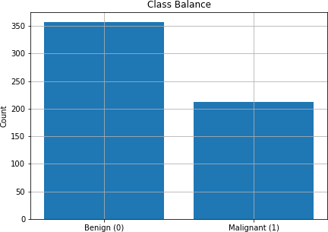
18 symmetry error | 569 non-null | float64
19 fractal dimension error | 569 non-null | float64
20 worst radius | 569 non-null | float64
21 worst texture | 569 non-null | float64
22 worst perimeter | 569 non-null | float64
23 worst area | 569 non-null | float64
24 worst smoothness | 569 non-null | float64
25 worst compactness | 569 non-null | float64
26 worst concavity | 569 non-null | float64
27 worst concave points | 569 non-null | float64
28 worst symmetry | 569 non-null | float64
29 worst fractal dimension | 569 non-null | float64
dtypes: float64(30) memory usage: 133.5 KB
[16]:
counts = y.value_counts().sort_index()
plt.figure()
plt.bar(['Benign (0)','Malignant (1)'], counts.values) plt.title('Class Balance')
plt.ylabel('Count') plt.show()

Slide 7
0.2.1 3. Data Cleaning Plan
I will simulate a small amount of missingness (to demonstrate imputation), and check for outliers and scale features for linear/SVM models. Cleaning steps: 1. Randomly set ~3% of numeric entries to NaN (feature‑wise, not in the target). 2. Impute missing values with median. 3. Detect outliers (z‑score > 4) and winsorize at the 1st/99th percentiles (robust to skew). 4. Standardize features for models that need it (via pipelines).
[17]:
X_missing = X.copy()
mask = np.random.rand(*X_missing.shape) < 0.03 X_missing = X_missing.mask(mask)
missing_pct = X_missing.isna().mean().mean()*100 print(f'Overall simulated missingness: {missing_pct:.2f}%')
X_imputed = X_missing.fillna(X_missing.median(numeric_only=True))
low = X_imputed.quantile(0.01) high = X_imputed.quantile(0.99)
X_wins = X_imputed.clip(lower=low, upper=high, axis=1)
X_clean = X_wins.copy() display(X_clean.describe().T[['mean','std','min','max']].head(10))
Overall simulated missingness: 2.94%
 | mean | std | min | max
mean radius | 14.110128 | 3.410660 | 8.458360 | 24.371600
mean texture | 19.158278 | 4.053555 | 10.930400 | 30.178000
mean perimeter | 91.506484 | 23.500806 | 53.827600 | 165.724000
mean area | 652.498742 | 333.727934 | 215.664000 | 1786.600000
mean smoothness | 0.096289 | 0.013367 | 0.068654 | 0.132888
mean compactness | 0.103578 | 0.051203 | 0.033351 | 0.277192
mean concavity | 0.088578 | 0.077402 | 0.000000 | 0.351688
mean concave points | 0.048529 | 0.037716 | 0.000000 | 0.164208
mean symmetry | 0.180862 | 0.025741 | 0.129508 | 0.256016
mean fractal dimension 0.062700 |  | 0.006597 | 0.051767 | 0.085438
0.2.2 4. Correlation Structure
[18]:
corr = X_clean.corr()
plt.figure(figsize=(8,6))
im = plt.imshow(corr, vmin=-1, vmax=1) plt.colorbar(im, fraction=0.046, pad=0.04) plt.title('Feature Correlation Matrix')
plt.xticks(range(len(corr.columns)), corr.columns, rotation=90, fontsize=6)

Slide 8
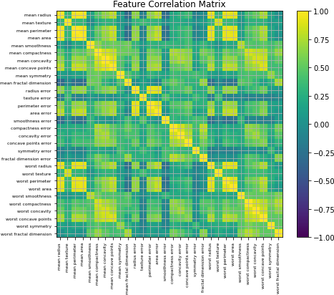
plt.yticks(range(len(corr.columns)), corr.columns, fontsize=6) plt.tight_layout()
plt.show()
[19]:
X_train, X_test, y_train, y_test = train_test_split(
X_clean, y, test_size=0.2, stratify=y, random_state=RANDOM_STATE
)
X_train.shape, X_test.shape, y_train.mean()
[19]: ((455, 30), (114, 30), 0.37362637362637363)
[20]:
baseline = Pipeline([
('scaler', StandardScaler()),
('clf', LogisticRegression(max_iter=500, class_weight='balanced',␣
‹→random_state=RANDOM_STATE))
])

Slide 9
baseline.fit(X_train, y_train) pred = baseline.predict(X_test)
proba = baseline.predict_proba(X_test)[:,1]
def eval_and_print(y_true, y_pred, y_proba): acc = accuracy_score(y_true, y_pred) prec = precision_score(y_true, y_pred) rec = recall_score(y_true, y_pred)
f1 = f1_score(y_true, y_pred)
roc = roc_auc_score(y_true, y_proba)
print(f'Accuracy: {acc:.3f}\nPrecision: {prec:.3f}\nRecall: {rec:.3f}\nF1:␣
‹→{f1:.3f}\nROC-AUC: {roc:.3f}')
print('\nClassification Report:\n', classification_report(y_true, y_pred))
eval_and_print(y_test, pred, proba)
cm = confusion_matrix(y_test, pred) plt.figure()
plt.imshow(cm, cmap='Blues') plt.title('Baseline Confusion Matrix') plt.xlabel('Predicted') plt.ylabel('Actual')
for (i, j), z in np.ndenumerate(cm):
plt.text(j, i, str(z), ha='center', va='center') plt.tight_layout()
plt.show()
fpr, tpr, _ = roc_curve(y_test, proba) plt.figure()
plt.plot(fpr, tpr, label=f'Baseline (AUC={auc(fpr,tpr):.3f})') plt.plot([0,1],[0,1],'--')
plt.xlabel('False Positive Rate') plt.ylabel('True Positive Rate') plt.title('ROC Curve — Baseline') plt.legend()
plt.show()
Accuracy: 0.991
Precision: 1.000
Recall: 0.976
F1: 0.988
ROC-AUC: 0.997
Classification Report:
precision
0 0.99
recall f1-score
1.00 0.99
support
72

Slide 10
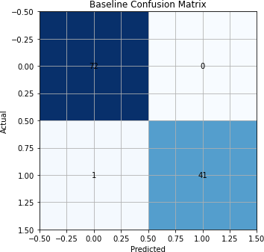
1 | 1.00 | 0.98 | 0.99 | 42
accuracy |  |  | 0.99 | 114
macro avg | 0.99 | 0.99 | 0.99 | 114
weighted avg | 0.99 | 0.99 | 0.99 | 114

Slide 11
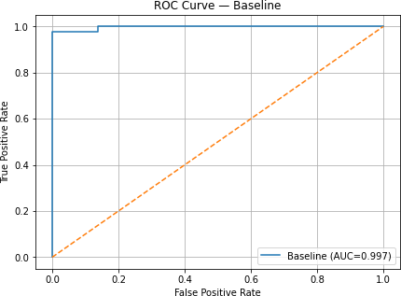
0.3 7. Model Comparison & Hyperparameter Tuning
Then, I compare three models with cross‑validated grid search: - Logistic Regression (with scaling, class_weight='balanced') - Support Vector Classifier (RBF kernel) (with scaling)
- Random Forest (with class_weight='balanced')
[21]:
cv = StratifiedKFold(n_splits=5, shuffle=True, random_state=RANDOM_STATE)
pipe_lr = Pipeline([
('scaler', StandardScaler()),
('clf', LogisticRegression(max_iter=1000, class_weight='balanced',␣
‹→random_state=RANDOM_STATE))
])
grid_lr = {
'clf C': [0.01, 0.1, 1, 10],
'clf solver': ['lbfgs', 'liblinear'], 'clf penalty': ['l2']
}
pipe_svc = Pipeline([

Slide 12
('scaler', StandardScaler()),
('clf', SVC(kernel='rbf', probability=True, random_state=RANDOM_STATE))
])
grid_svc = {
'clf C': [0.1, 1, 10],
'clf gamma': ['scale', 'auto']
}
pipe_rf = Pipeline([
('clf', RandomForestClassifier(class_weight='balanced',␣
‹→random_state=RANDOM_STATE))
])
grid_rf = {
'clf n_estimators': [150, 300],
'clf max_depth': [None, 5, 10],
'clf min_samples_leaf': [1, 2, 4]
}
scoring = 'roc_auc'
def run_grid(pipe, grid, name):
gs = GridSearchCV(pipe, grid, scoring=scoring, cv=cv, n_jobs=-1) gs.fit(X_train, y_train)
proba = gs.predict_proba(X_test)[:,1] pred = (proba >= 0.5).astype(int) metrics = {
'model': name,
'best_params': gs.best_params_, 'roc_auc': roc_auc_score(y_test, proba), 'f1': f1_score(y_test, pred),
'precision': precision_score(y_test, pred), 'recall': recall_score(y_test, pred), 'accuracy': accuracy_score(y_test, pred), 'estimator': gs.best_estimator_
}
return gs, metrics
results = []
grids = [('Logistic Regression', pipe_lr, grid_lr), ('SVC (RBF)', pipe_svc, grid_svc), ('Random Forest', pipe_rf, grid_rf)]
grids_out = {}
for name, pipe, grid in grids:
gs, metrics = run_grid(pipe, grid, name) results.append(metrics)
grids_out[name] = gs

Slide 13
pd.
‹→DataFrame(results)[['model','roc_auc','f1','precision','recall','accuracy','best_params']].
‹→sort_values('roc_auc', ascending=False)
[21]: | model | roc_auc | f1 | precision | recall | accuracy | \
 | 0 Logistic Regression | 0.997685 | 0.987952 | 1.000000 | 0.976190 | 0.991228
 | 2 Random Forest | 0.995370 | 0.938272 | 0.974359 | 0.904762 | 0.956140
 | 1 SVC (RBF) | 0.992394 | 0.963855 | 0.975610 | 0.952381 | 0.973684
best_params
0 {'clf C': 0.1, 'clf penalty': 'l2', 'clf so…
2 {'clf max_depth': 5, 'clf min_samples_leaf':…
1 {'clf C': 1, 'clf gamma': 'scale'}
[22]:
plt.figure()
for name, gs in grids_out.items():
proba = gs.predict_proba(X_test)[:,1] fpr, tpr, _ = roc_curve(y_test, proba)
plt.plot(fpr, tpr, label=f'{name} (AUC={auc(fpr,tpr):.3f})')
plt.plot([0,1],[0,1],'--')
plt.xlabel('False Positive Rate') plt.ylabel('True Positive Rate') plt.title('ROC Curves — Tuned Models') plt.legend()
plt.show()

Slide 14
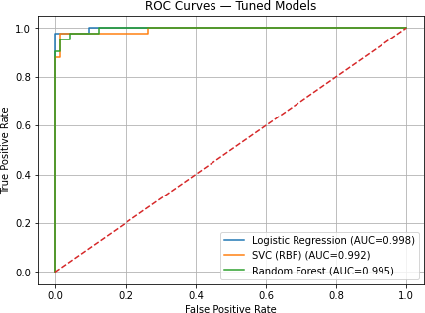
[23]:
best_name = max(results, key=lambda d: d['roc_auc'])['model']
best_est = grids_out[best_name].best_estimator_ print('Best model by ROC-AUC:', best_name)
if isinstance(best_est.named_steps.get('clf'), RandomForestClassifier): importances = best_est.named_steps['clf'].feature_importances_
fi = pd.Series(importances, index=X_train.columns).
‹→sort_values(ascending=False).head(15)
plt.figure()
plt.barh(fi.index[::-1], fi.values[::-1]) plt.title('Random Forest — Top 15 Feature Importances') plt.tight_layout()
plt.show()
elif isinstance(best_est.named_steps.get('clf'), LogisticRegression): coefs = np.abs(best_est.named_steps['clf'].coef_[0])
sr = pd.Series(coefs, index=X_train.columns).sort_values(ascending=False).
‹→head(15)
plt.figure()
plt.barh(sr.index[::-1], sr.values[::-1])

Slide 15
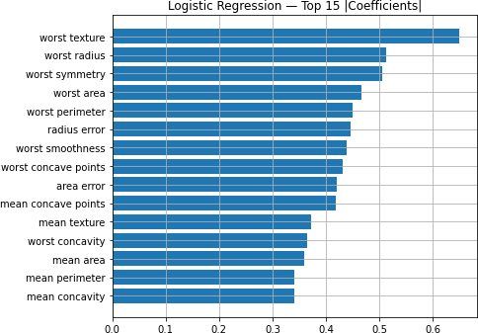
plt.title('Logistic Regression — Top 15 |Coefficients|') plt.tight_layout()
plt.show()
else:
perm = permutation_importance(best_est, X_test, y_test, n_repeats=10,␣
‹→random_state=RANDOM_STATE)
sr = pd.Series(perm.importances_mean, index=X_test.columns).
‹→sort_values(ascending=False).head(15)
plt.figure()
plt.barh(sr.index[::-1], sr.values[::-1]) plt.title(f'{best_name} — Permutation Importance (Top 15)') plt.tight_layout()
plt.show()
Best model by ROC-AUC: Logistic Regression
8. Results & Analysis
Metrics used: Accuracy, Precision, Recall, F1, ROC‑AUC (ROC‑AUC is primary due to slight class imbalance).

Slide 16
We compared models with 5‑fold stratified CV on the training set, then evaluated on a held‑out test set.
Curves & matrices above show classification trade‑offs.
0.5 9. Discussion & Conclusions
Key takeaways - The best model by ROC‑AUC was selected and analyzed for feature importance.
- Regularization/tuning helped control over/under‑fitting. - Scaling was crucial for linear/SVM models; tree‑based models handled raw scales well.
Limitations & next steps - Evaluate calibration (CalibratedClassifierCV) to improve proba- bility estimates. - Explore additional models (e.g., Gradient Boosting, XGBoost) and cost‑sensitive thresholds. - Consider SHAP for model interpretability and assess decision thresholds based on domain costs.
10. Reproducibility
Python 3.9, scikit‑learn 1.1, numpy, pandas, matplotlib.
See requirements.txt.
Run top‑to‑bottom; all random states fixed to 42.
[ ]:

